Slide 1

Trash-Bugged An AI Product to fight Littering
From House of
Team
CODEBUGGED

Slide 2

The Problem Statement
Geo tracking of waste and Triggering Alerts and Mapping Areas with High waste Index
CDK global company launched this problem statement in Smart India Hackathon – 2020.
We have built an AI product which could solve this problem issue.
The model could detect the Trash by using Artificial Intelligence and the geo tag it on Google map
Once tagged on google map, it can be accessed by municipalities.
This work has future scope in recycling and reusing of waste, leading to a sustainable waste management

Slide 3

01
02
03
04
Use AI to detect waste
Gather the Location
Geo tag them on map
Recycle Reuse Replenish
Artificial Intelligence technique will classify the wastes
We will gather the location by the lat. and long. Of the camera device
The locations will be geo tagged on map
Its depends on the quality of waste what we can do with them
The Algorithm

Slide 4

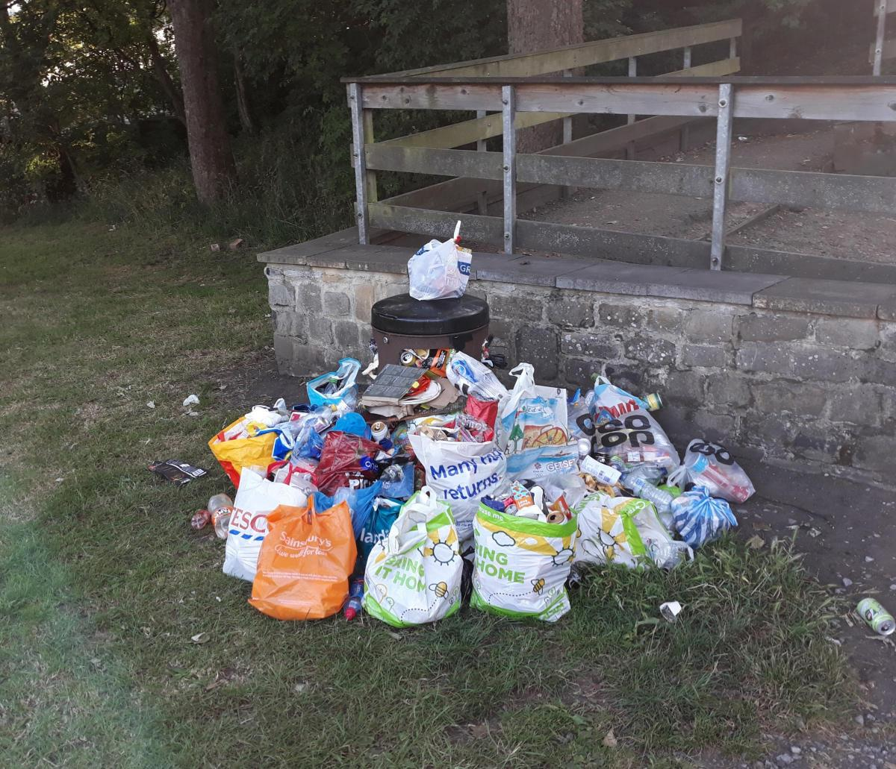
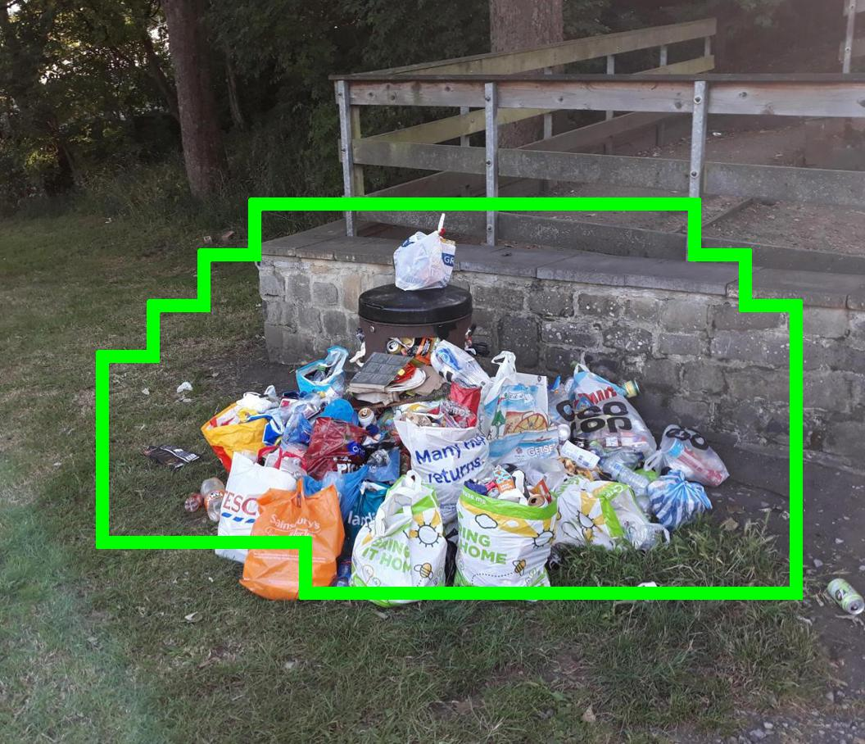
A picture is worth Thousand Words

Slide 5
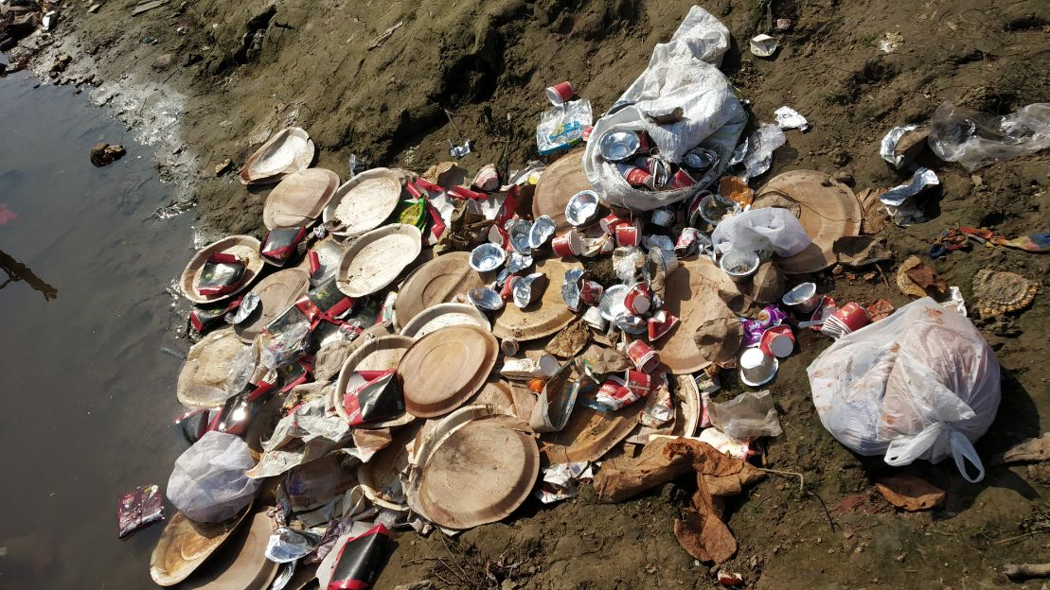
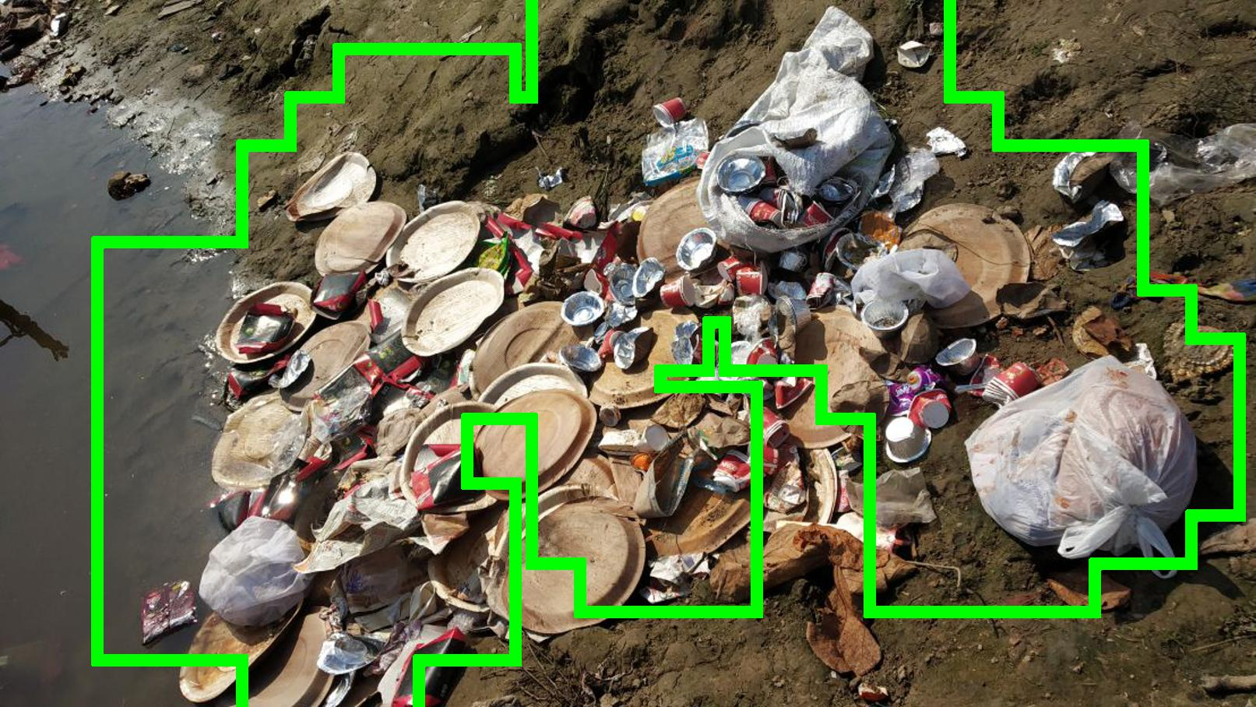

Slide 6
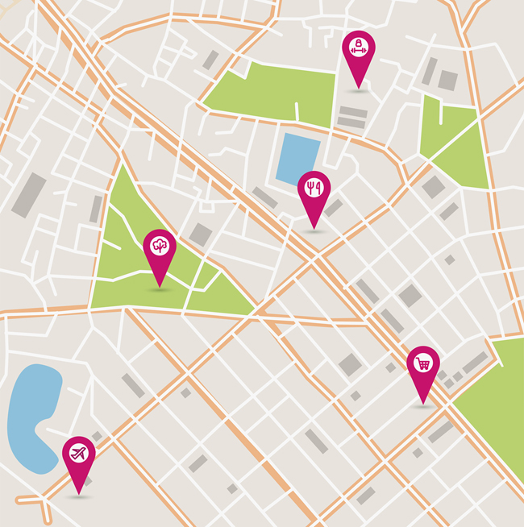
Geotagging The Locations
This is how it will be appearing on real time map and thus will be used by the municipalities to detect the high waste index.

Slide 7

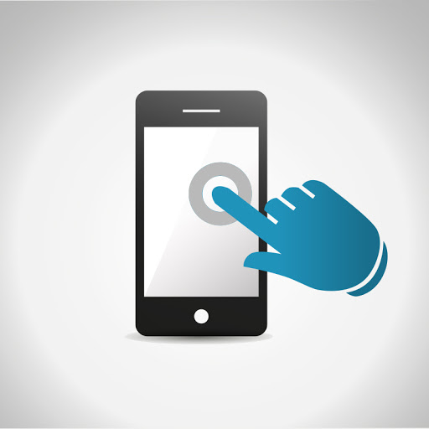

Mobile App
Global Website
Users can download the app and click the garbage image and it will be automatically geo tagged
This can be used where smart phones are not available or in drones.

Slide 8
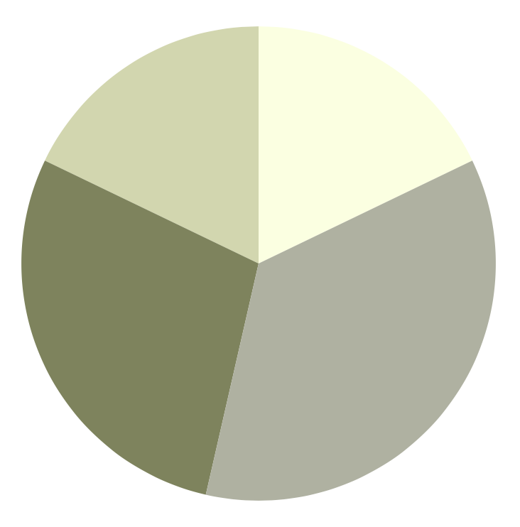
Our Future Clients
17.9%
17.9%
28.6%
35.7%
Others
Factories and Warehouses
River bodies management
State Governments
To modify this graph, click on it, follow the link, change the data and paste the new graph here

Slide 9


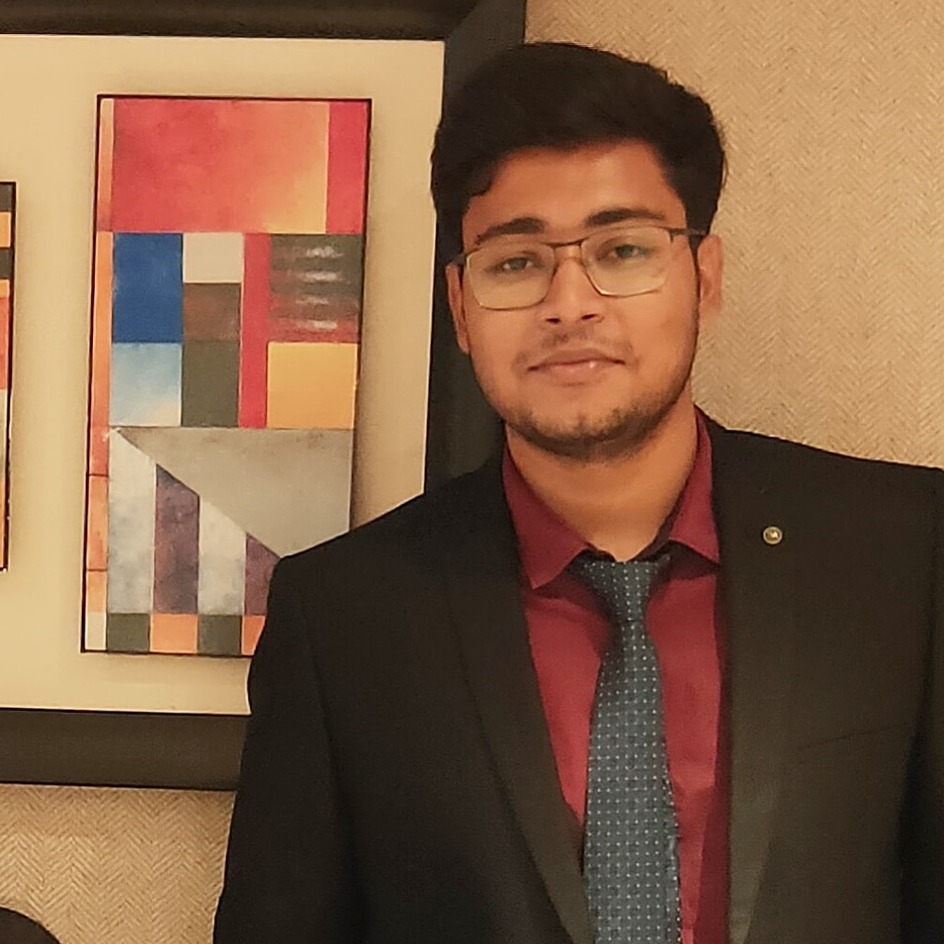

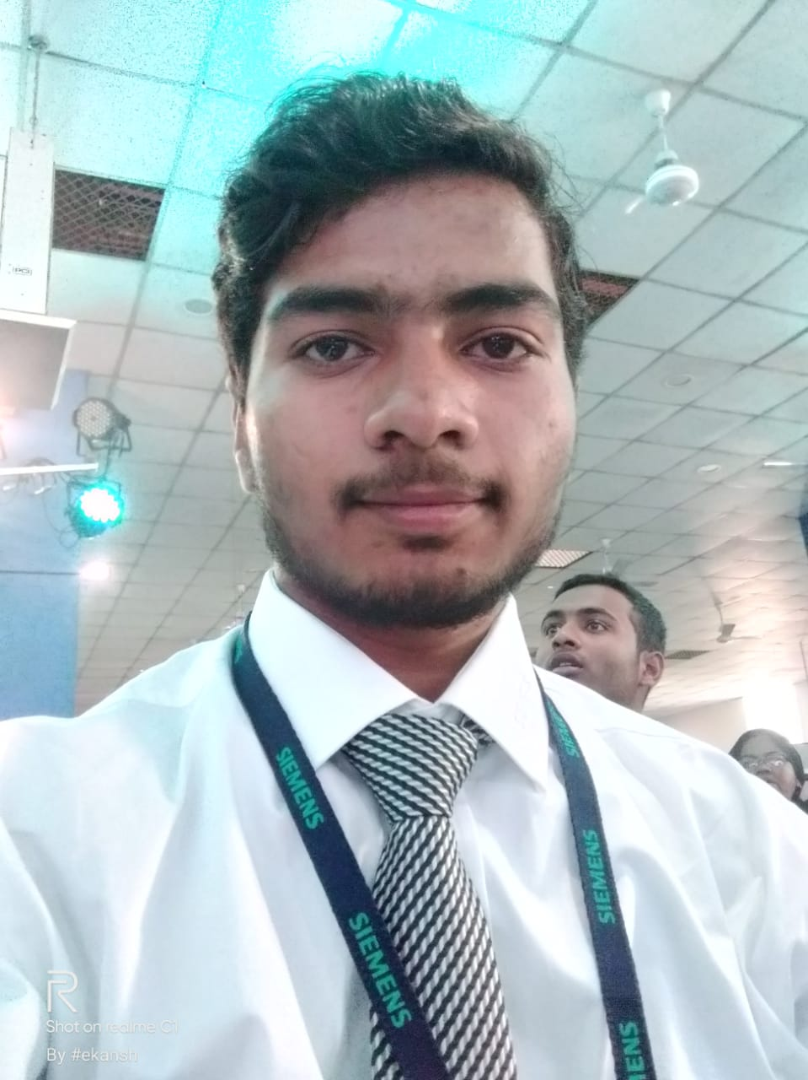

The Creators
Sarthak Srivastava
AI Engineer
Gaurav Singh
AI Engineer
Abhinav K. Singh
Data Science Engineer
Divyanshi Singh
App Developer
Ekansh Saxena
Web/Android Developer
Saurabh Soni
IoT Developer

Slide 10
Thanks!
Do you have any questions?
thecodebugged@gmail.com
+91-8004006979
Let’s make this world a better place to Live
Please keep this slide for attribution.

